Slide 2
What’s New in Xamarin.Forms
B8099
David Ortinau | Senior Program Manager, Mobile Developer Tools | @davidortinau
Jason Smith | Engineering Team Lead | @jassmith87

Slide 3

Glad to be here – flood photo
photo credit: stltoday.com

Slide 4




Xamarin Native approach
iOS C#
Android C#
Windows C#
Shared C# Logic
3 Native User Interfaces
Shared App Logic

Slide 5
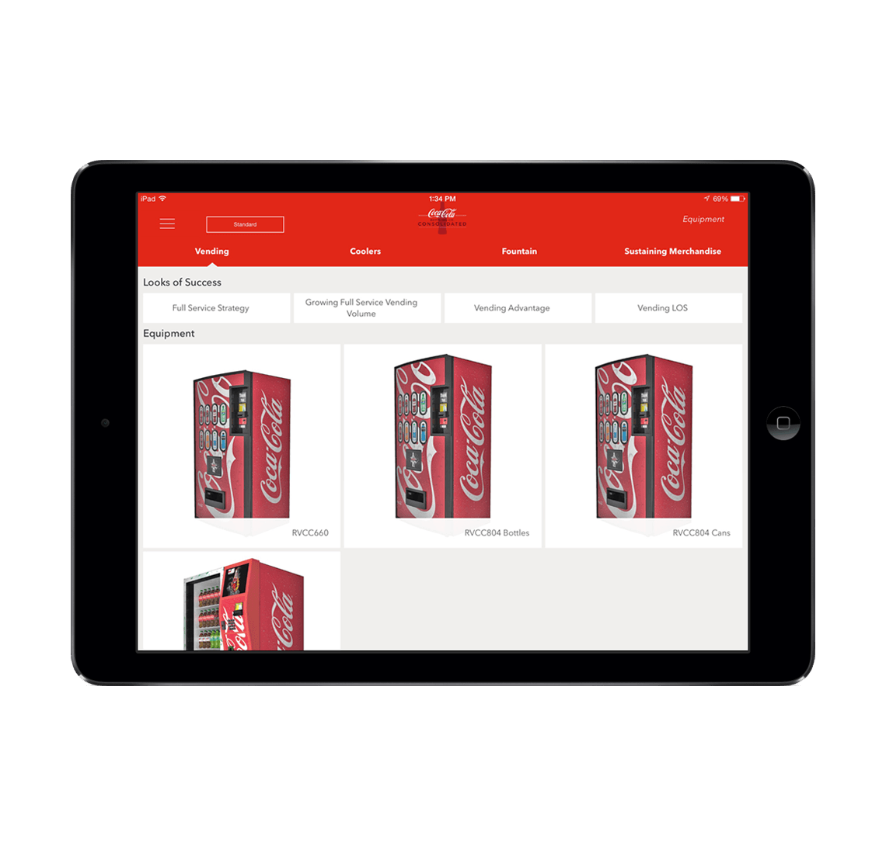
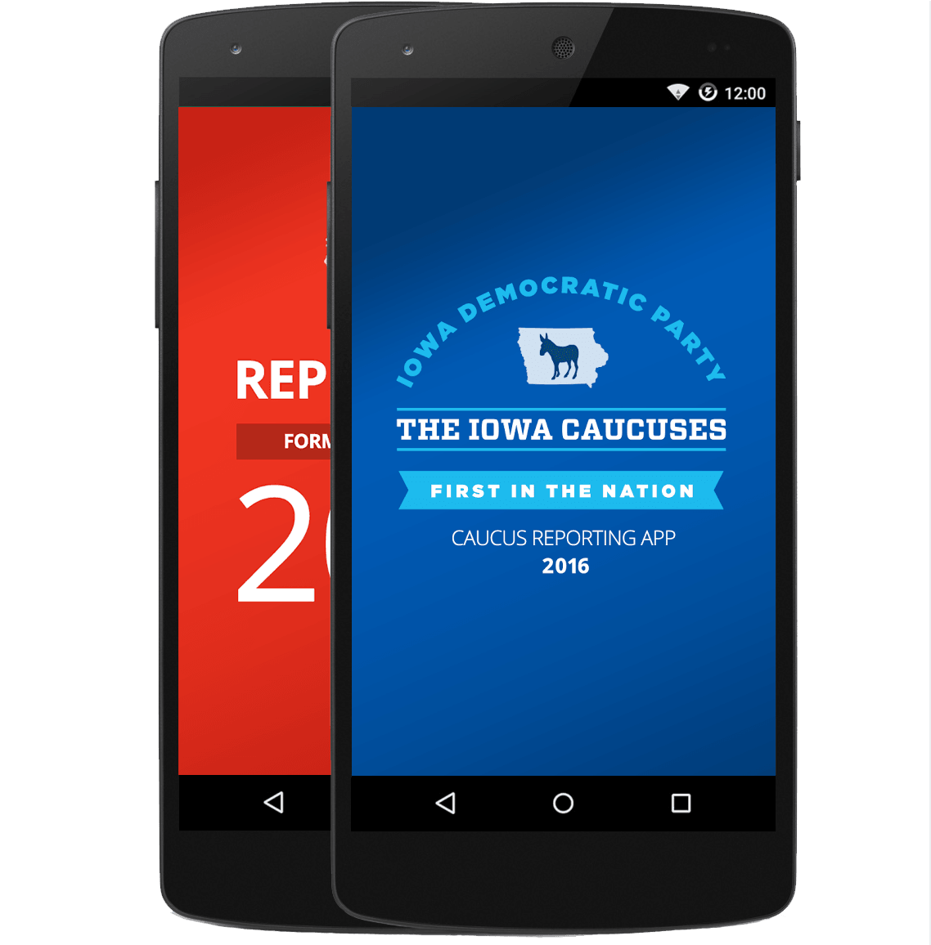
Xamarin.Forms approach
Shared UI Code
Shared C# Logic
Shared (Native) User Interfaces
Shared App Logic

Slide 6
1 Year of Open Source!

Slide 7
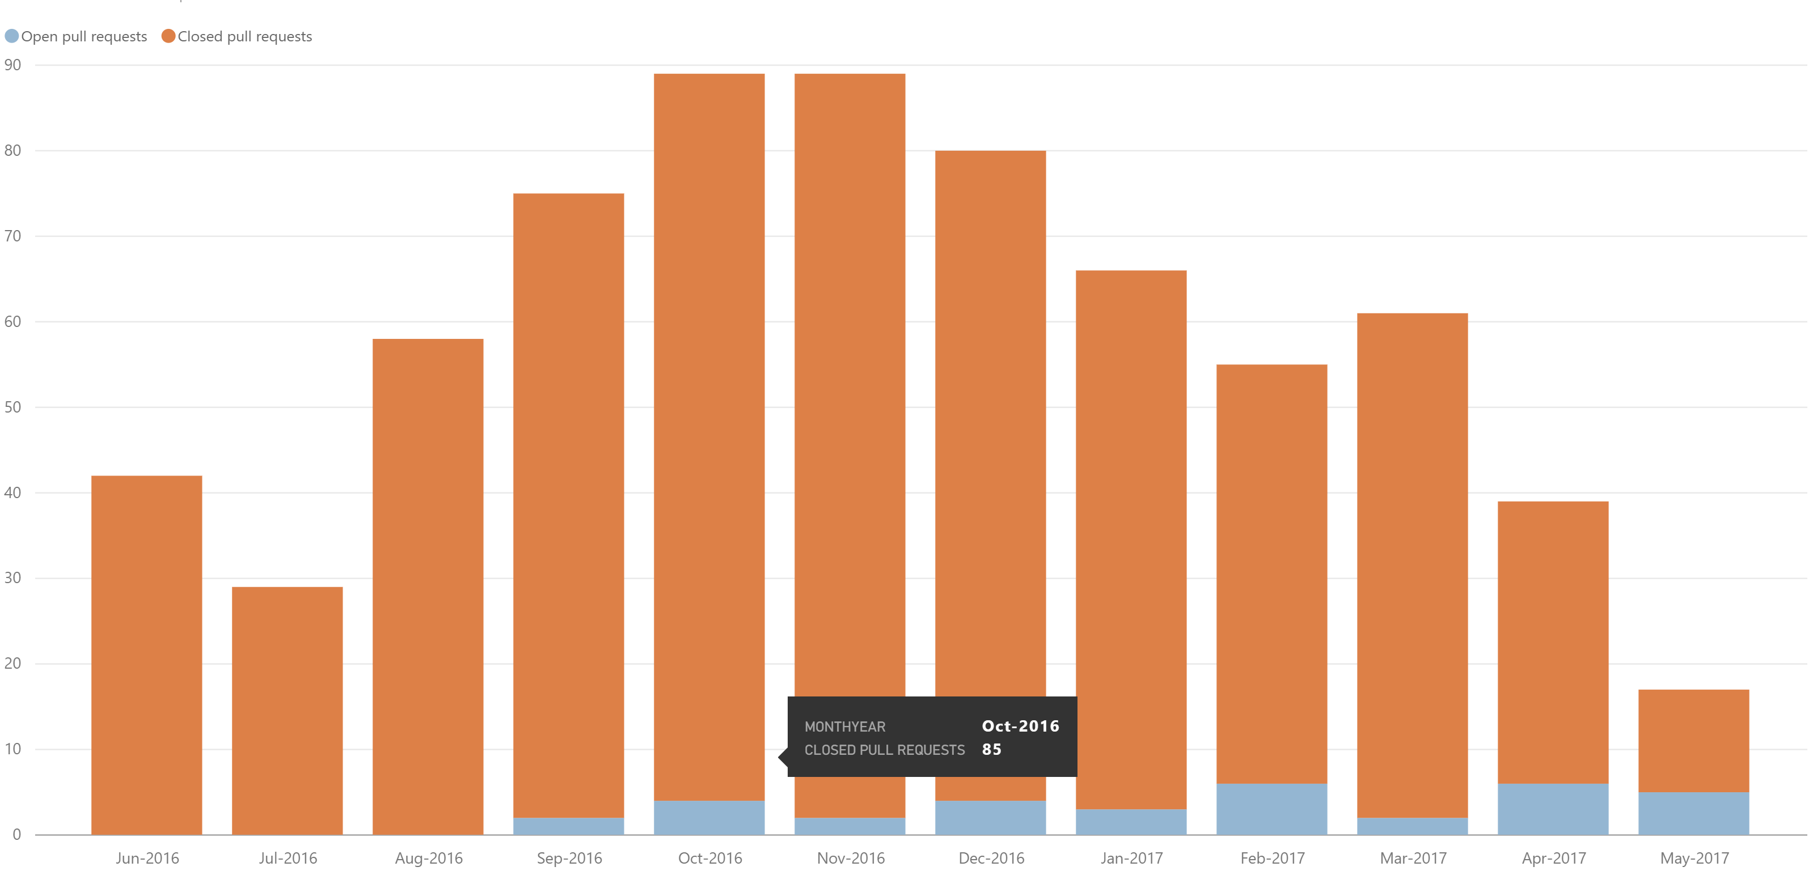
Community
Public Roadmap: aka.ms/xfroadmap
70 contributors
700 merged pull requests
37 evolution proposals

Slide 8
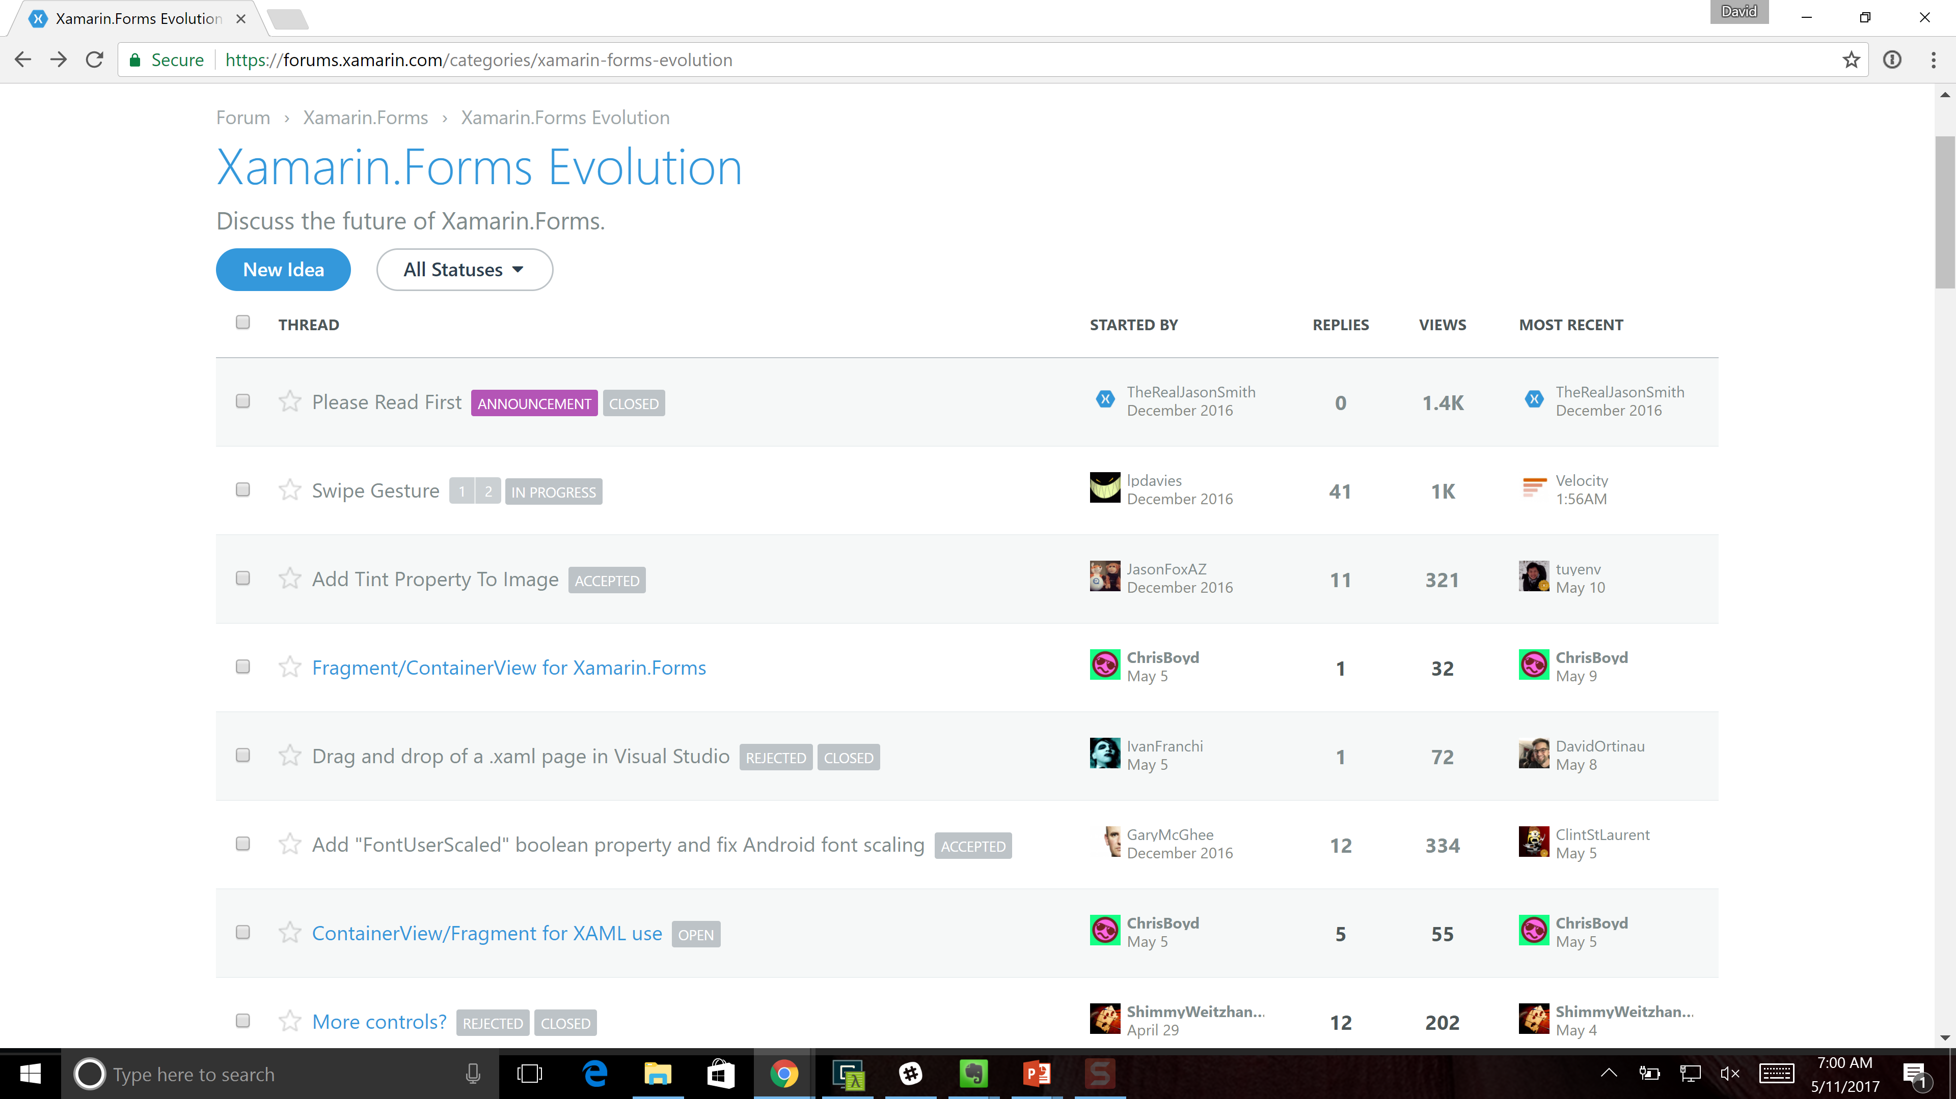
Xamarin.Forms Evolution
aka.ms/xfevolution
Title, Summary, API

Slide 9
Features and Enhancements
Fast Renderers Preview
Memory Improvements
Native Control Binding
Bindable Picker
Map Extensibility
Startup Time
XAMLC
Forms Previewer
Android Support Libraries
FlexLayout Preview
Frame Corners
Enhanced GestureRecognizers
Tizen
Blur Behind
macOS Preview
Themes
ListView Scrolling
Embedded Native Controls
Deep Linking
.netstandard support
Styles
Fast Scroll
Xamarin.Forms Embedding
NavigationPage Translucency
Accessibility
PlatformSpecifics
Partial Collapse MasterPage
DataPages

Slide 10
Extended Ecosystem
Forms Community Toolkit
GrapeCity
Infragistics
mfractor
Syncfusion
Telerik
The Xamarin Show | Channel 9
UXDivers
Xamarin Podcast - xamarinpodcast.com

Slide 11


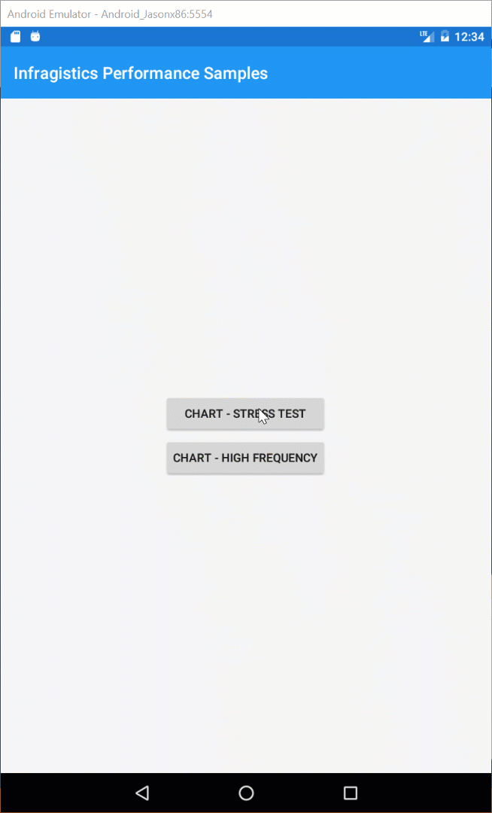

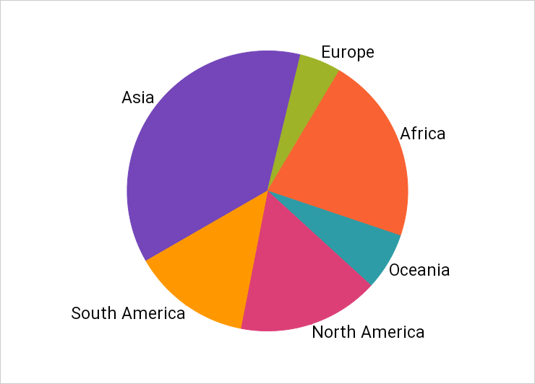
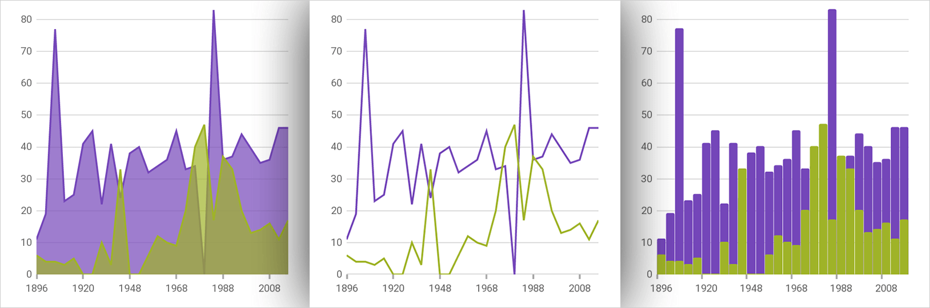

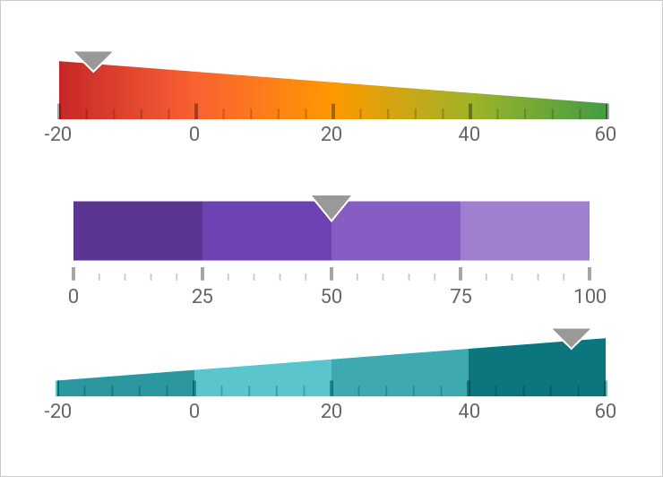
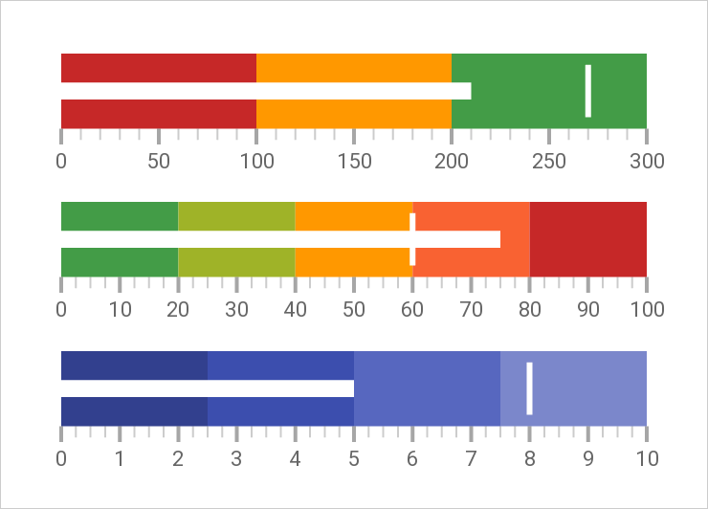
Infragistics Ultimate UI for Xamarin
The complete toolkit for building fast, beautiful, native mobile apps
Lightning-fast UI controls
Data grids gracefully render even the heaviest data loads
Data charts that handle millions of data points with millisecond refresh rates
Revolutionary WYSIWYG design tools for Xamarin.Forms
Free trial: www.infragistics.com/xamarin 20% off for Build attendees through July 15 – Use promo code MSBUILD17

Slide 12
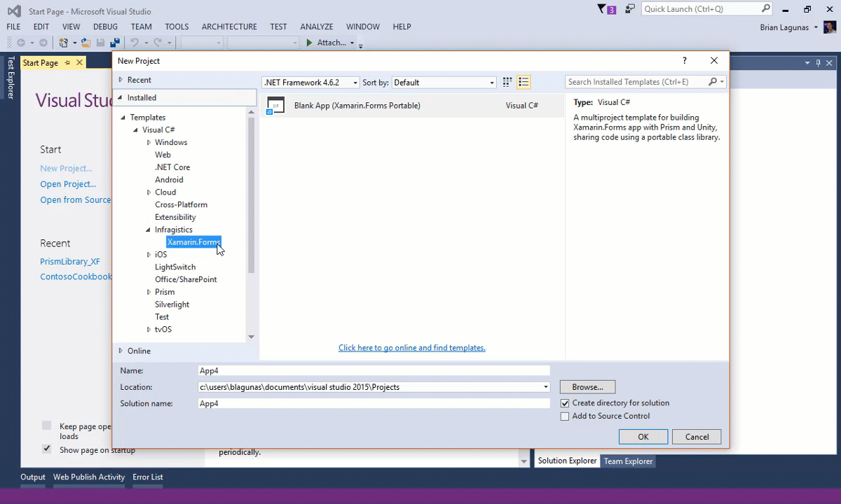
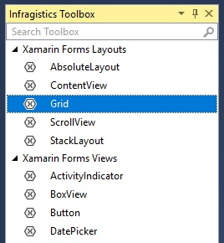
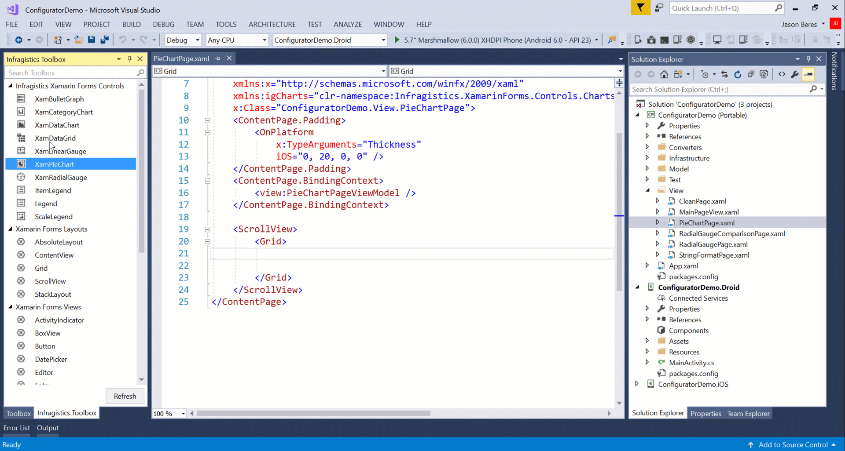
Infragistics Ultimate UI for Xamarin Productivity Pack
Revolutionary WYSIWYG design tools for Xamarin.Forms
Write Fast: App Map
Lay out your entire app Visio-style
Drag and drop pages, child relationships, and navigation instructions
Automatically generate views, view models, and navigation code
Write Fast: Visual Toolbox
World’s first NuGet-powered toolbox for Xamarin.Forms
Features all standard layouts, views and controls
Automatic namespace referencing
Write Fast: Control Configurators
Easy visual control configuration right in the XAML editor
Easy, intuitive property editing and data binding
Auto-generate XAML code
Auto-update properties upon XAML code changes
Free trial: www.infragistics.com/xamarin 20% off for Build attendees through July 15 – Use promo code MSBUILD17

Slide 13

Why Telerik UI for Xamarin
Polished UI controls out of the box
Allows developers to focus on app features, rather sweating UI details
Native controls for Xamarin.iOS & Xamarin.Android
Cross-platform wrappers for Xamarin.Forms
Extreme performance tuned
Works seamlessly on Windows/Mac
Easy integration through NuGet and Templates
Lot of customization options
Sample apps in Stores
The Best .NET UI for .NET Ninjas!
telerik.com/xamarin-ui

Slide 14

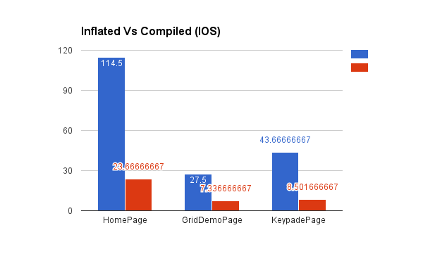
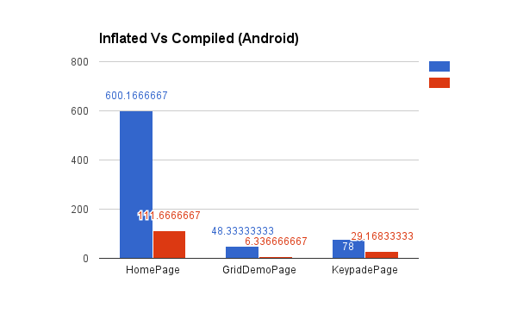
Quality and Performance
Aggressive bug triage
New issues reviewed within 24 hrs
Reproduction projects for quick resolution
Performance Improvements
Startup Time
Fast Renderers for Android
ListView improvements, Fast Scroll
XAMLC – 5x faster
Discussion: aka.ms/xfperformance
Source: Matthew Robbins - MFractor

Slide 15
What have you done for me lately?

Slide 16














david.ortinau@microsoft.com
@davidortinau

Slide 17
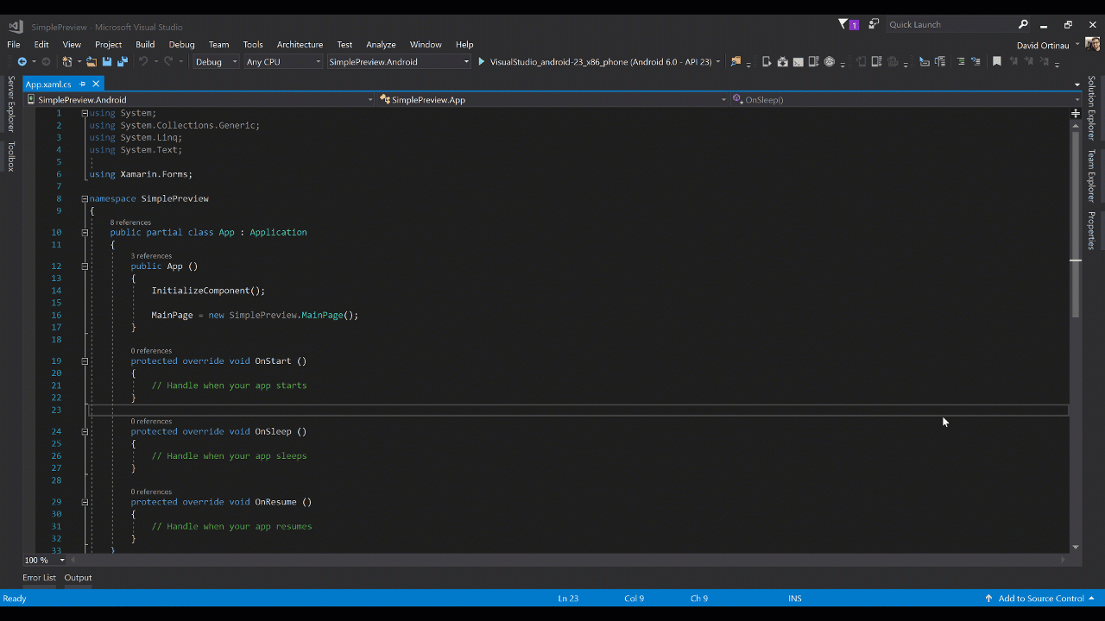
Xamarin.Forms Previewer
Visual Studio for Mac & Visual Studio 2015 / 2017

Slide 18
Xamarin Live Player with Xamarin.Forms xamarin.com/live

Slide 19
Available Today: Xamarin.Forms 2.3.5-pre3
.NET Standard Compatible
Recommend 1.1+ target
Fast Renderers for Android
Button, Image, Label
Accessibility
XAMLC type improvements
160+ bug fixes and enhancements
macOS Preview

Slide 20

Introducing Jason Smith
Xamarin.Forms Team

Slide 21
The Future: Xamarin.Forms 3.0

Slide 22
Performance Improvements

Slide 23
Layout Compression

Slide 24
Layout Lifecycle: Invalidation Loop
InvalidateMeasure Called
1
2
Call InvalidateMeasure on Parent
3
Has Parent?
Yes
No
4
Queue Delay Layout

Slide 25
Layout Lifecycle: Layout Loop
InvalidateMeasure Called
1
Layout called
6
2
Call InvalidateMeasure on Parent
7
LayoutChildren Invoked
5
3
Has Parent?
Has Children?
8
Wait for event callback to happen and trigger the layout mechanism
Yes
Yes
No
No
4
Queue Delay Layout
9
Layout Cycle Completed

Slide 26
Forms
Grid
StackLayout
ContentView
Button
Grid
Label
Label
WebView
Button
Image
ScrollView
Image
UWP
Panel
Panel
Panel
ButtonRenderer
Panel
LabelRenderer
LabelRenderer
WebViewRenderer
ButtonRenderer
ImageRenderer
ScrollViewRenderer
ImageRenderer
TextBlock
Button
WebView
Label
Button
Image
Image

Slide 27
Forms
Grid
StackLayout
ContentView
Button
Grid
Label
Label
WebView
Button
Image
ScrollView
Image
UWP+Compression
Panel
ButtonRenderer
LabelRenderer
LabelRenderer
WebViewRenderer
ButtonRenderer
ImageRenderer
ScrollViewRenderer
ImageRenderer
TextBlock
Button
WebView
Label
Button
Image
Image

Slide 28
Fast Renderers

Slide 29
Forms
Grid
StackLayout
ContentView
Button
Grid
Label
Label
WebView
Button
Image
ScrollView
Image
UWP+Compression
Panel
ButtonRenderer
LabelRenderer
LabelRenderer
WebViewRenderer
ButtonRenderer
ImageRenderer
ScrollViewRenderer
ImageRenderer
TextBlock
Button
WebView
Label
Button
Image
Image

Slide 30
Forms
Grid
StackLayout
ContentView
Button
Grid
Label
Label
WebView
Button
Image
ScrollView
Image
UWP+Compression+Fast Renderers
Panel
ButtonRenderer
LabelRenderer
LabelRenderer
WebViewRenderer
ButtonRenderer
ImageRenderer
ScrollViewRenderer
ImageRenderer
WebView

Slide 31
Fast Renderers
Available now in 2.3.5 for Android
- Image, Label, and Button only
Please Test!

Slide 32
Features

Slide 33
FlexLayout
A CSS FlexBox inspired layout system
Used for
Flowing items
Adaptive layout

Slide 34
FlexLayout Example
<?xml version="1.0" encoding="UTF-8"?>
<ContentPage xmlns="http://xamarin.com/schemas/2014/forms"
xmlns:x=http://schemas.microsoft.com/winfx/2009/xaml
x:Class="FormsFlexLayoutDemo.FlexDemoPage">
<FlexLayout x:Name="flexbox”>
<Label Text="Flex Element 1" />
<Label Text="Flex Element 2" />
<Label Text="Flex Element 3" />
<Label Text="Flex Element 4" />
<Label Text="Flex Element 5" />
</FlexLayout>
</ContentPage>
Flex Element 1
Flex Element 2
Flex Element 3
Flex Element 4
Flex Element 5

Slide 35
FlexLayout Properties
AlignContent
AlignItems
Position
Overflow
Wrap
Order
AlignSelf
Flex
JustifyContent
IsIncluded
Grow
Shrink

Slide 36
ListView Improvements
Faster loading
Direct item insertion
Remove need to use Cells

Slide 37
Standardized Renderer API

Slide 38
Also to be included
OneTime Binding
Continued XAMLC Improvements
CSS-Like Styling
Visual State Manager
Better adaptive layout - mirror UWP relative layout

Slide 39
Embedding
Works on ContentPages
Full support for DependencyService and MessagingCenter
Xamarin.Forms
Android Java
iOS
Obj-C
Swift
iOS C#
Android C#
Windows C#
?
Shared C# Logic

Slide 40
New Backends:

Slide 41
New Backends: Tizen

Slide 42
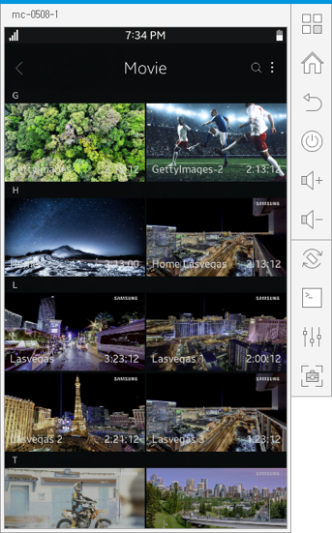
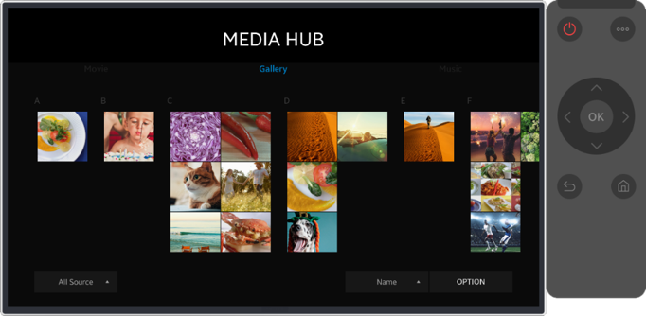

Slide 43
New Backends: WPF

Slide 44
New Backends: GTK#

Slide 45
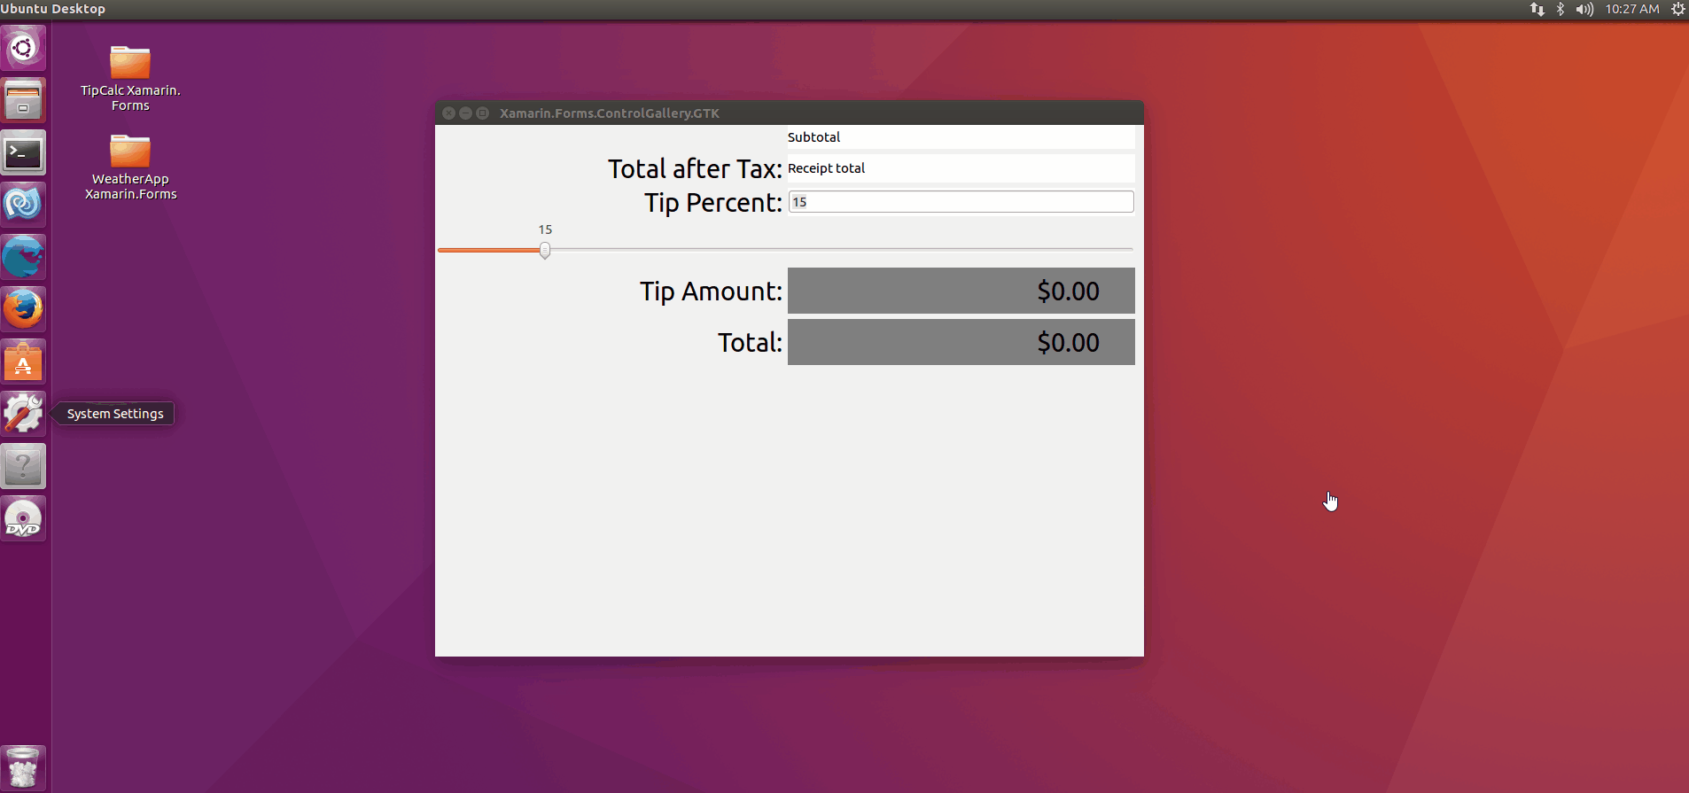

Slide 46
New Backends: macOS

Slide 47
Demo macOS

Slide 48
Demo Xamarin.Forms Embedding

Slide 49
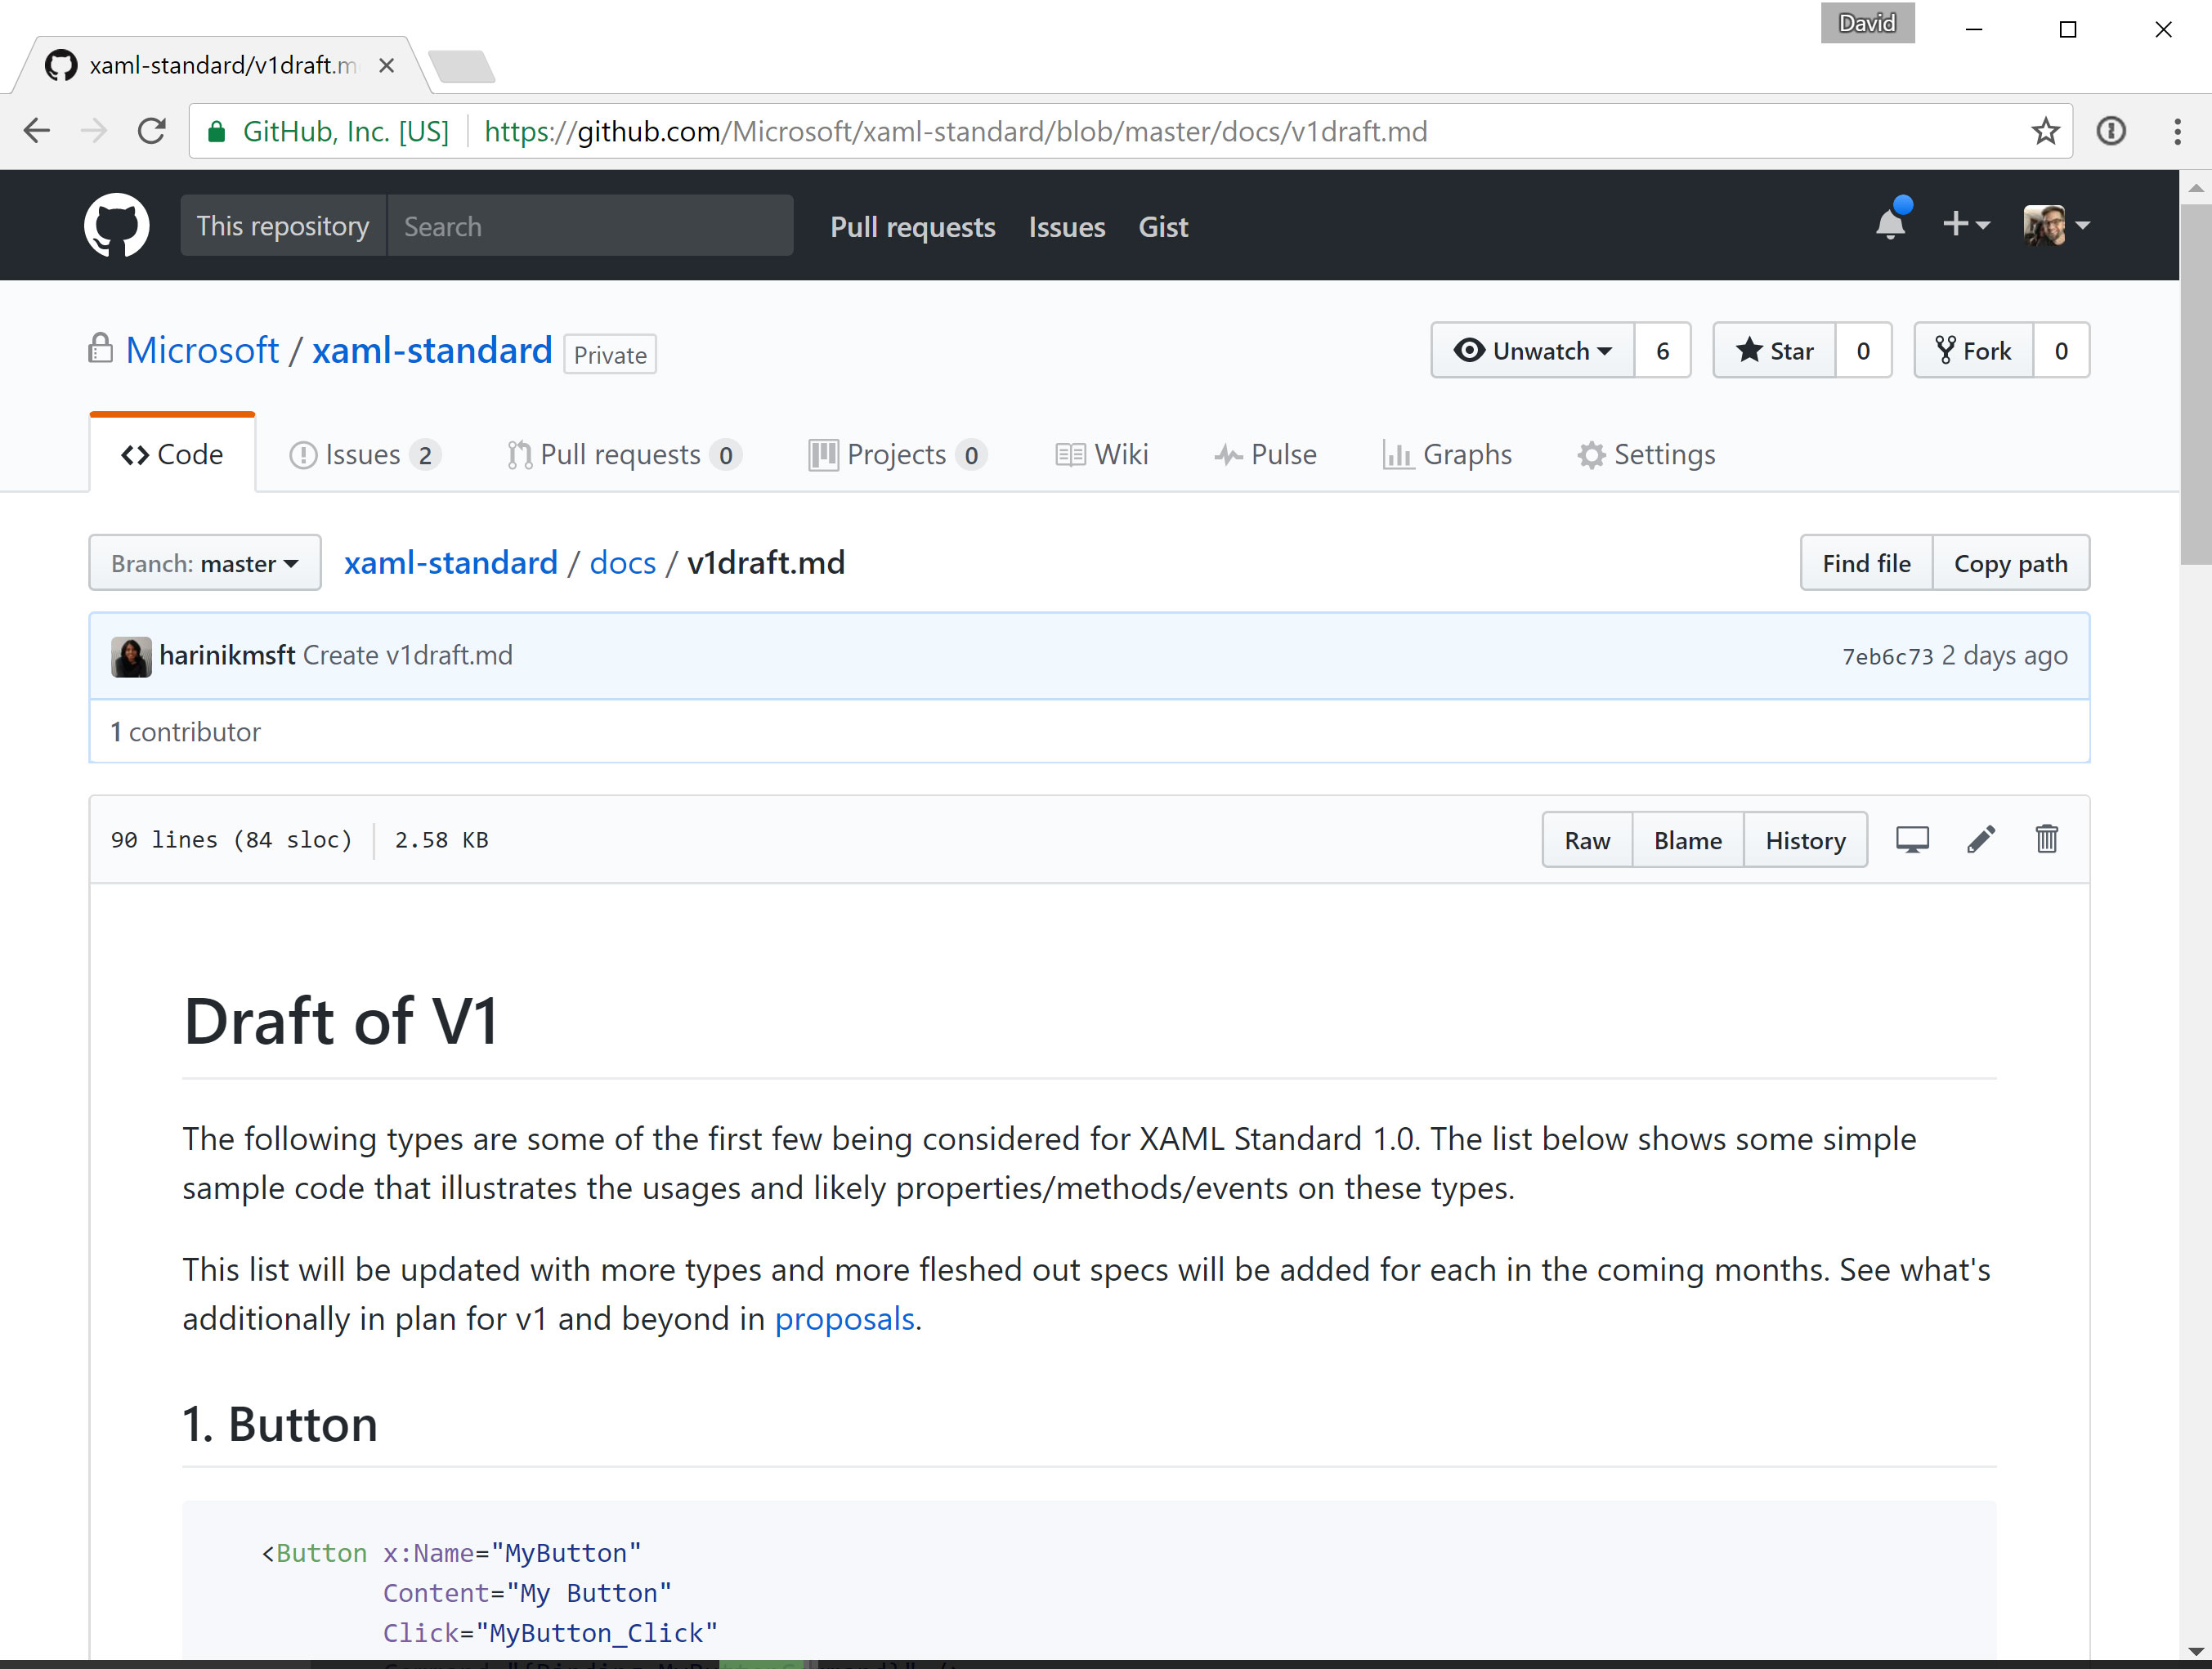
XAML Standard
github.com/Microsoft/xaml-standard

Slide 50
What’s Next?
Download Xamarin.Forms 2.3.5-pre3 today!
Watch for 3.0 Pre-release soon.
www.xamarin.com/download

Slide 51
Thank you.
Questions?
David
Ortinau
Senior Program Manager, Microsoft
Jason
Smith
Engineering Team Lead, Microsoft
david.ortinau@microsoft.com
@davidortinau
jas@microsoft.com
@jassmith87

